Slide 1
Lecture 10: Convolutional Neural Networks 1

Slide 2

A Convolutional Network
+ ReLU
+ ReLU

Slide 3
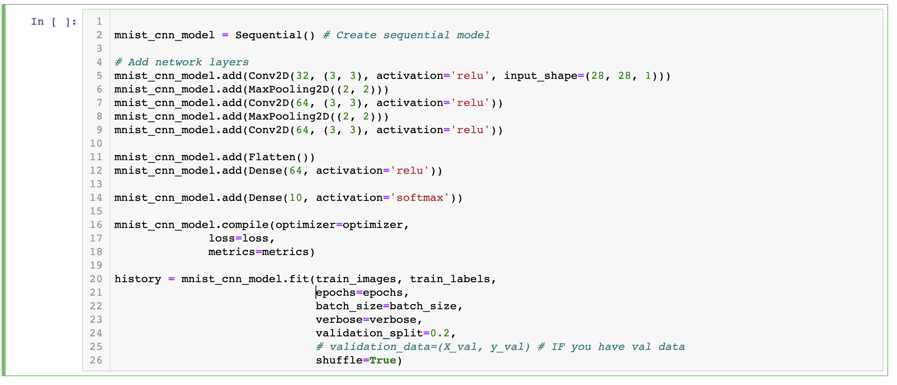
The code

Slide 4
DONE

Slide 5
Outline
Motivation
CNN basic ideas
Building a CNN

Slide 6
Outline
Motivation
CNN basic ideas
Building a CNN

Slide 7
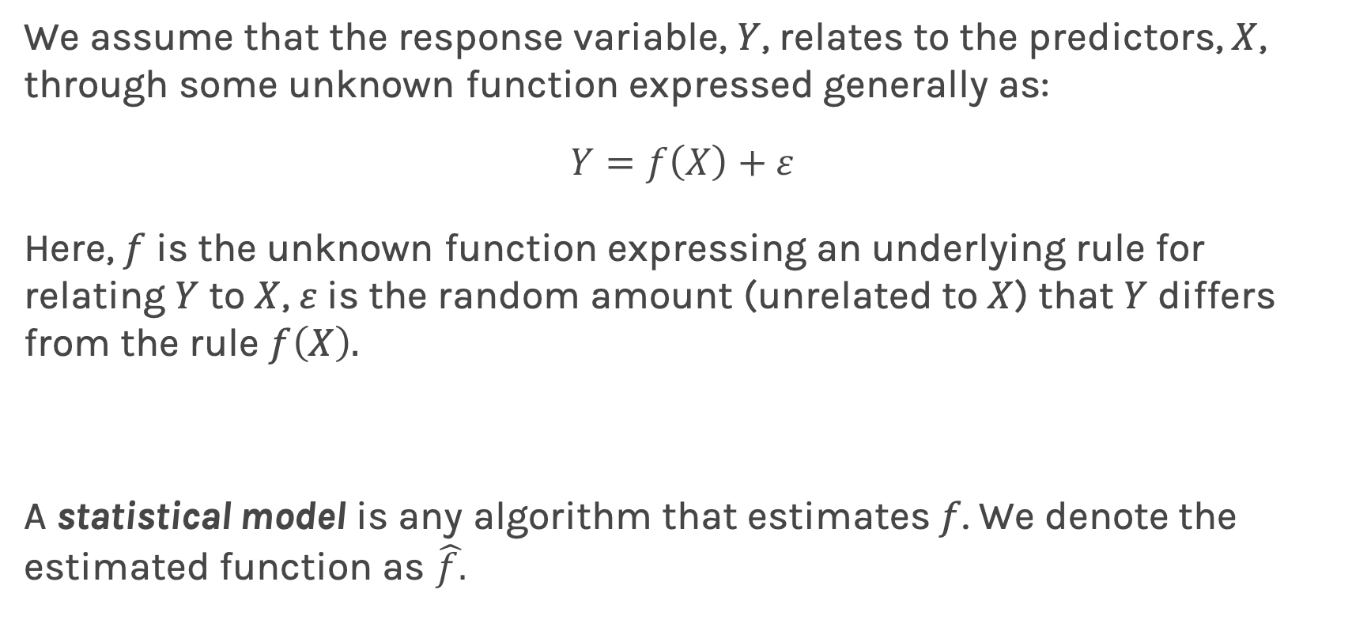
Feedforward Neural Network, Multilayer Perceptron (MLP)
We assume that the response variable, $Y$, relates to the predictors, $X$, through some unknown function expressed generally as:
$$Y=f\left(X\right)+ε$$
Here, $f$ is the unknown function expressing an underlying rule for relating $Y$ to $X$, $ε$is the random amount (unrelated to $X$) that $Y$ differs from the rule $f\left(X\right).$
A statistical model is any algorithm that estimates $f$. We denote the estimated function as $\hat{f.}$

Slide 8
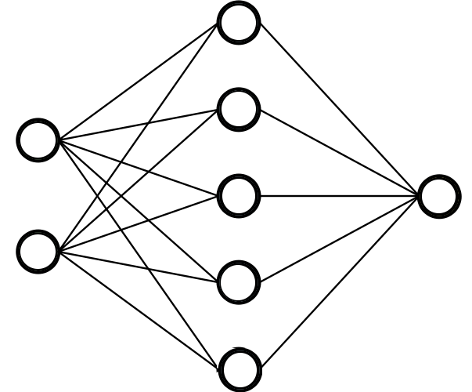
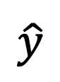

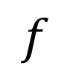
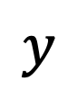
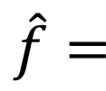
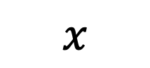
Feedforward Neural Network, Multilayer Perceptron (MLP)
A function is a relation that associates each element $x$ of a set $X$ to a single element $y$ of a set $Y$
$$x$$
$$f$$
$$y$$
Neural networks can approximate a wide variety of functions
$$x$$
$\hat{f}=$
$$\hat{y}$$

Slide 9
Quick review of MLPs
Activation depends on task
I do not like calling it a layer
Loss function
input layer
output layer
Loss function depends on task
hidden layer 1
hidden layer 2
Learn weights and biases using backpro and gradient descent

Slide 10
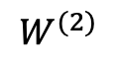
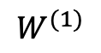
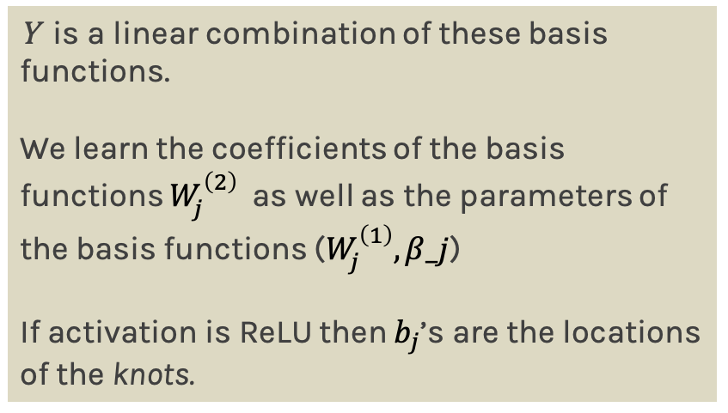
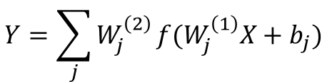
MLP as an additive model
activation
$$W^{(1)}$$
$$W^{(2)}$$
$$Y=\sum_{j}{W_{j}^{\left(2\right)}}f(W_{j}^{\left(1\right)}X+b_{j})$$
X
Y
Basis functions.
Y is a linear combination of these basis functions.
We learn the coefficients of the basis functions $W_{j}^{\left(2\right)}$ as well as the parameters of the basis functions ($W_{j}^{\left(1\right)}, β_j$)
If activation is ReLU then $b_{j}$’s are the locations of the knots.
input layer
output layer
hidden layer 1

Slide 11

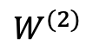
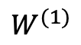
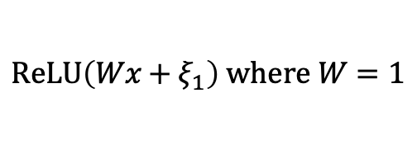
MLP as an additive model (cont)
From lecture 1:
E(Y|x)$=α_{0}+α_{1}x+β_{1}{\left(x−ξ_{1}\right)}_{+}$+$β_{2}{\left(x−ξ_{2}\right)}_{+}+…+β_{k}{\left(x−ξ_{k}\right)}_{+}$
Minor modification:
E(Y|x)$=α_{0}+β_{0}{\left(x−∞\right)}_{+}+β_{1}{\left(x−ξ_{1}\right)}_{+}$+$β_{2}{\left(x−ξ_{2}\right)}_{+}+…+β_{k}{\left(x−ξ_{k}\right)}_{+}$
$$ReLU\left(Wx+ξ_{1}\right) where W=1$$
$$W^{(1)}$$
$$W^{(2)}$$
Location of Knots can be learned as well as the $β$’s and $α_{0}$
X
Y
input layer
hidden layer 1

Slide 12
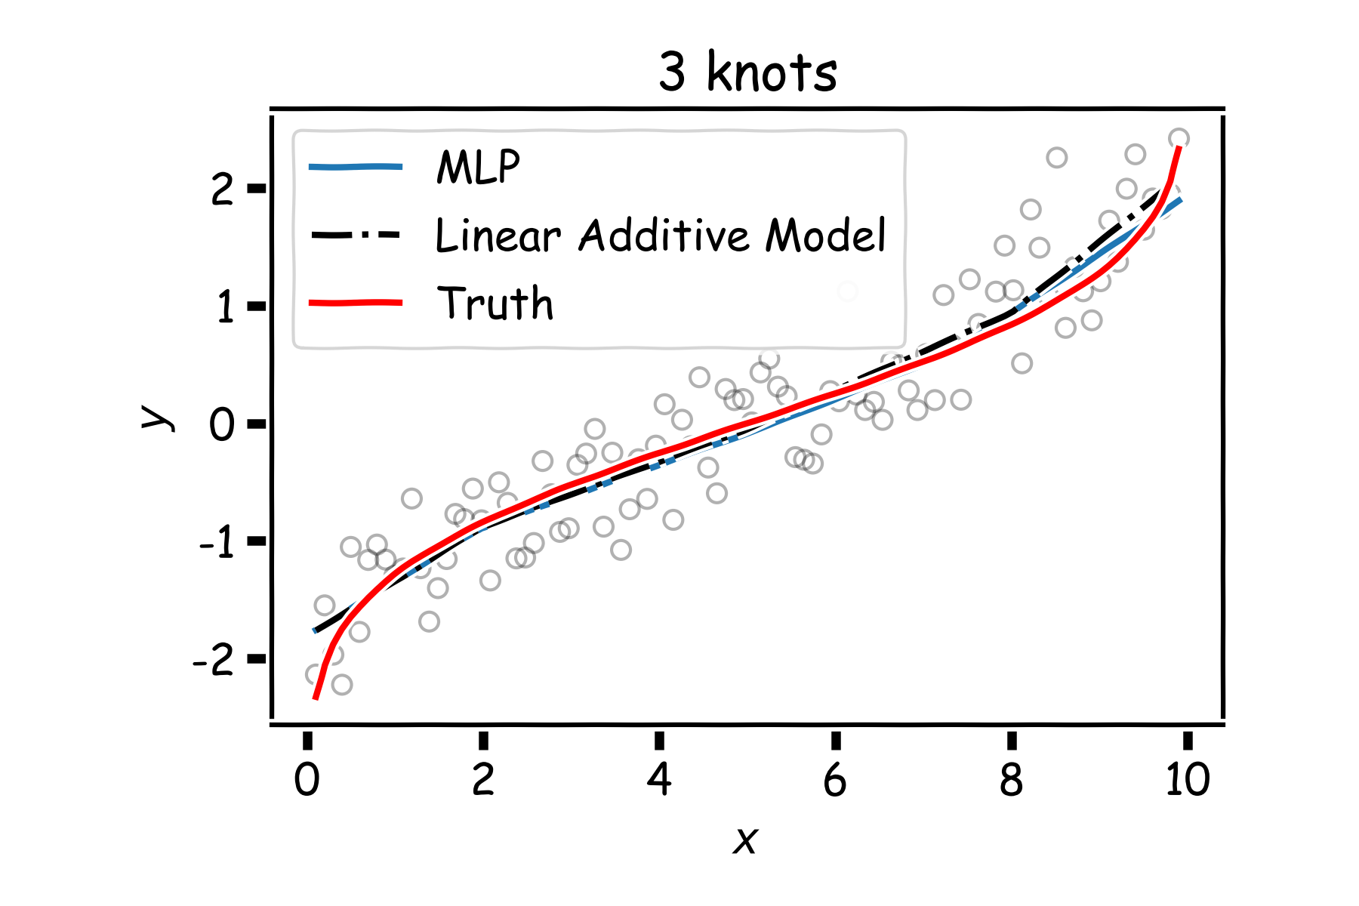
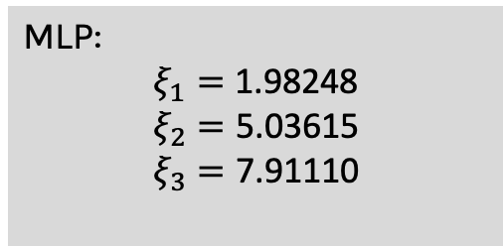
MLP as an additive model (cont)
MLP:
$$ξ_{1}=\text{1.98248}$$
$$ξ_{2}=\text{5.03615}$$
$$ξ_{3}=\text{7.91110}$$

Slide 13
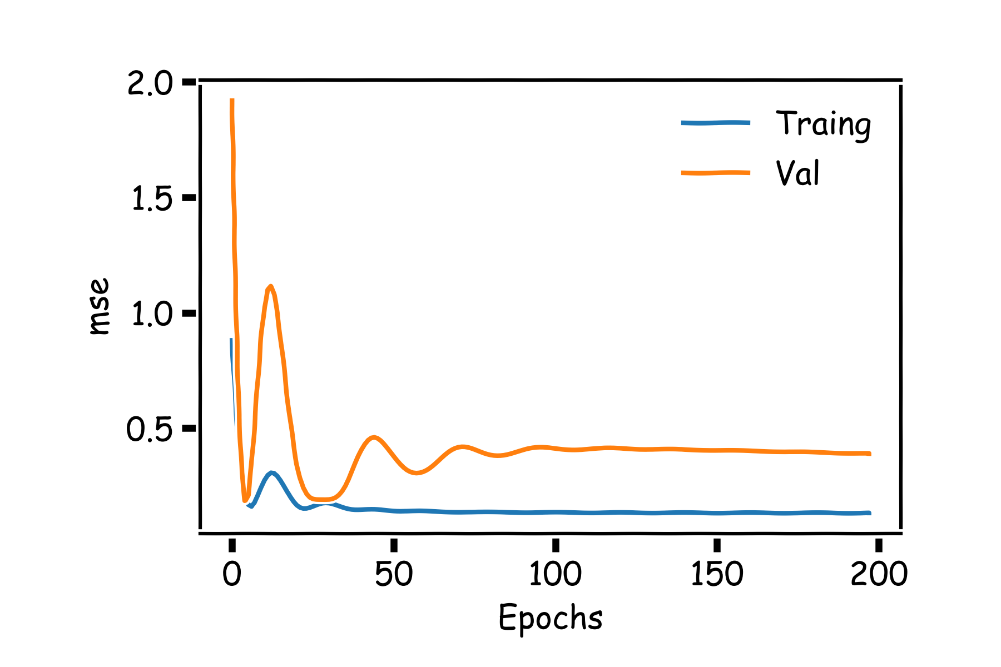
MLP as an additive model (cont)
If we add more neurons, it clearly overfits.
CS109A Lecture 21:
Regularization of NN
Norm Penalties
Early Stopping
Data Augmentation
Sparse Representation
Dropout

Slide 14
Main drawbacks of MLPs
MLPs use one node for each input (e.g. pixel in an image, multiplied by 3 in RGB case). The amount of weights rapidly becomes unmanageable for large images.
Training difficulties arise, overfitting can appear.
MLPs react differently to an input (images) and its shifted version – they are not translation invariant.

Slide 15
Main drawbacks of MLPs
MLPs use one node for each input (e.g. pixel in an image, multiplied by 3 in RGB case). The amount of weights rapidly becomes unmanageable for large images.
Training difficulties arise, overfitting can appear.
MLPs react differently to an input (images) and its shifted version – they are not translation invariant.

Slide 16
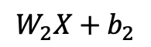
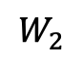
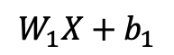
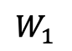
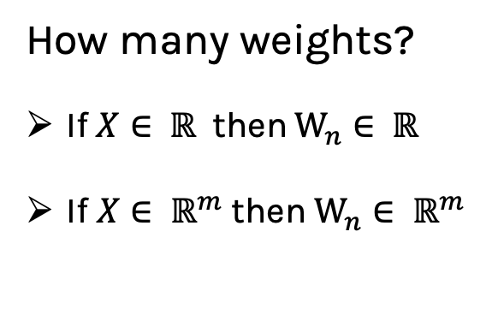
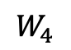
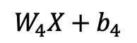
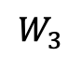
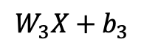
MLP: number of weights
$$W_{1}X+b_{1}$$
$$W_{1}$$
How many weights?
If $X∈ ℝ$ then $W_{n}∈ ℝ$
If $X∈ ℝ^{m}$then $W_{n}∈ ℝ^{m}$
$$W_{2}$$
$$W_{2}X+b_{2}$$
X
$$W_{3}$$
$$W_{4}$$
$$W_{3}X+b_{3}$$
input layer
$$W_{4}X+b_{4}$$
hidden layer 1

Slide 17

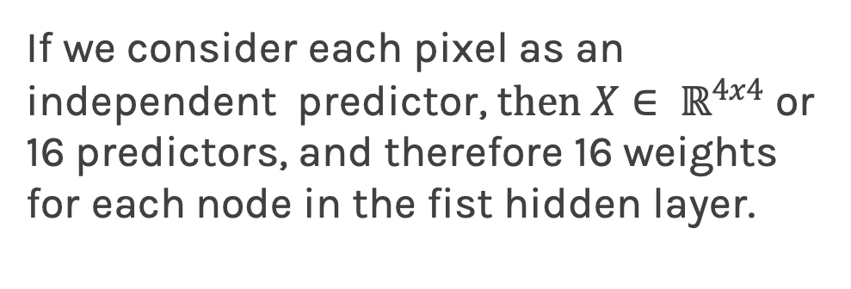
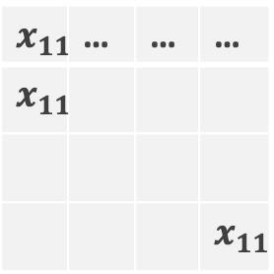
MLP: number of weights for images
If we consider each pixel as an independent predictor, t$hen X∈ ℝ^{4x4}$or 16 predictors, and therefore 16 weights for each node in the fist hidden layer.
$$x_{11}$$ | … | … | …
$$x_{11}$$
 |  |  | $$x_{11}$$
From 109A Lecture 7:
A strong motivation for performing model selection is to avoid overfitting, which we saw can happen when:
there are too many predictors:
the feature space has high dimensionality
the polynomial degree is too high
too many cross terms are considered

Slide 18
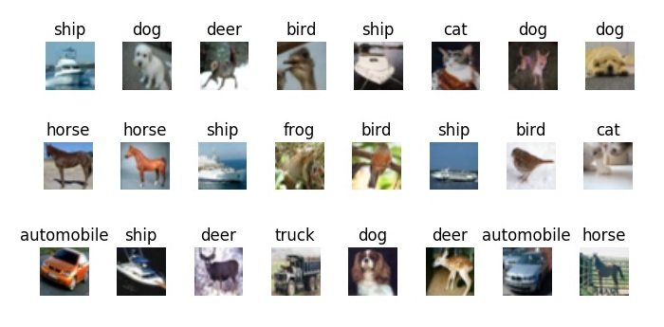
MLP: number of weights for images
Example: CIFAR10
Simple 32x32 color images (3 channels)
Each pixel is a feature: an MLP would have 32x32x3+1 = 3073 weights per neuron!

Slide 19
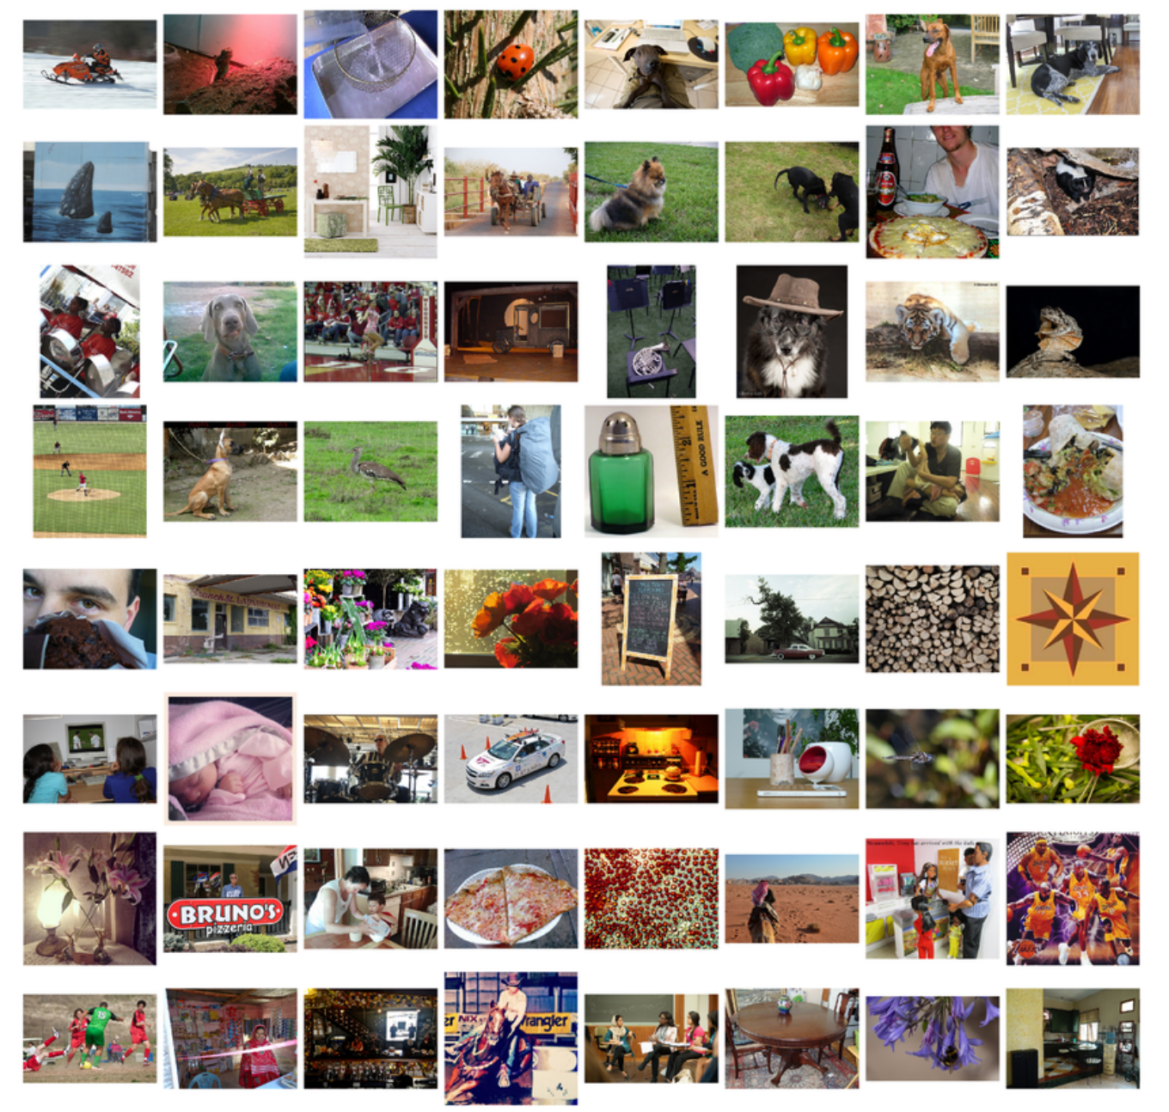
MLP: number of weights for images
Example: ImageNet
Images are usually 224x224x3: an MLP would have 150129 weights per neuron. If the first layer of the MLP is around 128 nodes, which is small, this already becomes very heavy to calculate.
Model complexity is extremely high: overfitting.

Slide 21
Model Selection and Dimensionality Reduction
Recall from 109A to reduce the number of predictors we can:
PCA
Stepwise Variable Selection
Regularization, in particular L1 will produce sparsity
Drop predictors that are highly correlated
Summarize input (image) with high level features => feature extraction or representation learning

Slide 22
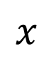

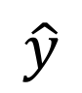
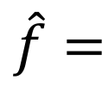
Feature extraction
Features:
Bald
Grey hair
Oval shape head
Glasses
Awesome
$$x$$
$$x′$$
$\hat{f}=$
$$\hat{y}$$
Features:
Bald
Grey hair
Oval shape head
No Glasses
Awesome

Slide 23

Model Selection and Dimensionality Reduction
Features:
Bald
Grey hair
Oval shape head
No Glasses
Awesome ?
Features:
Not Bald
Dark hair
Oval shape head
Glasses
Extremely Awesome

Slide 24
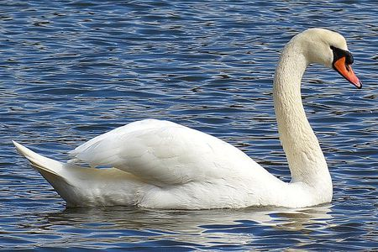
Image analysis
Imagine that we want to recognize swans in an image:
Round, elongated oval with orange protuberance
Oval-shaped white blob (body)
Long white rectangular shape (neck)

Slide 25
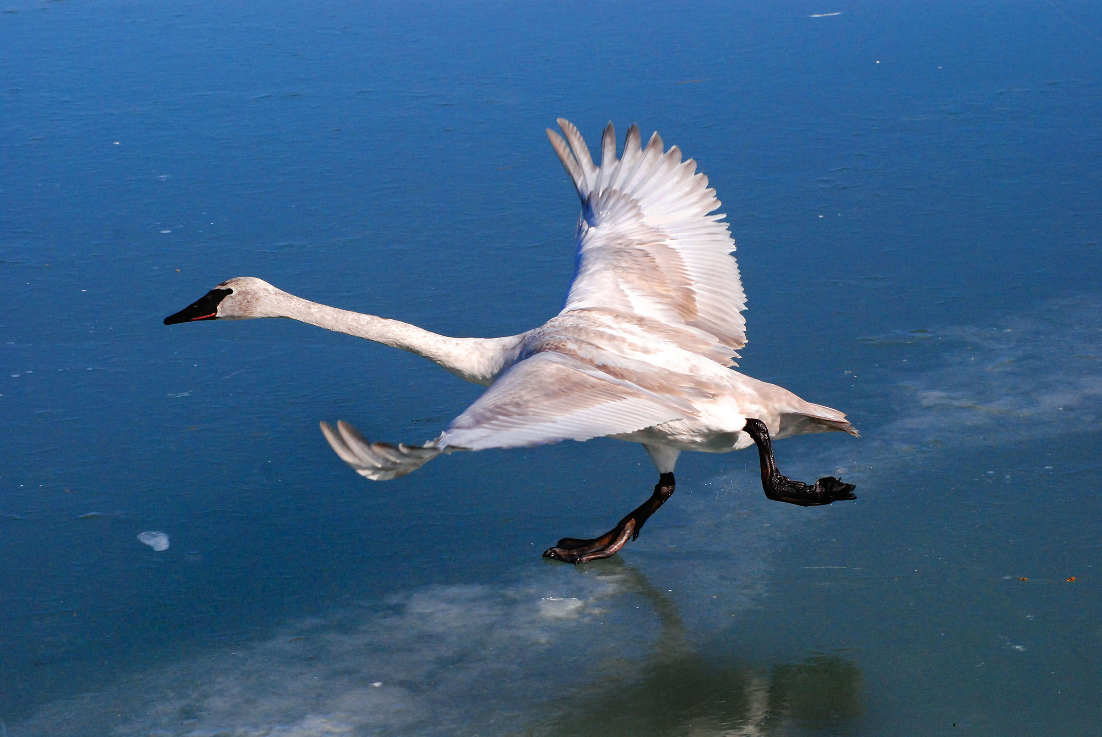
Cases can be a bit more complex…
Round, elongated head with orange or black beak
Oval-shaped white body with or without large white symmetric blobs (wings)
Long white neck, square shape

Slide 26
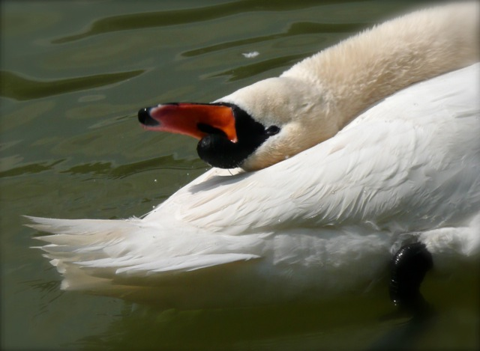
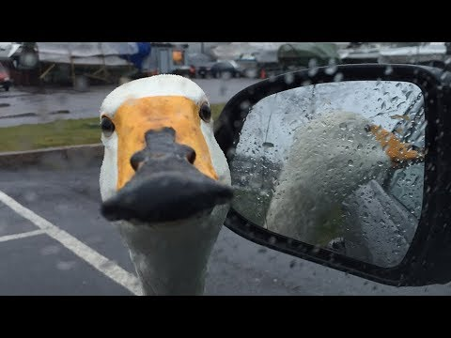
Now what?
Round, elongated head with orange or black beak, can be turned backwards
Small black circles, can be facing the camera, sometimes can see both
Long white neck, can bend around, not necessarily straight
Black triangular shaped form, on the head, can have different sizes
White tail, generally far from the head, looks feathery
White elongated piece, can be squared or more triangular, can be obstructed sometimes
Luckily, the color is consistent…
Black feet, under body, can have different shapes
White, oval shaped body, with or without wings visible

Slide 27
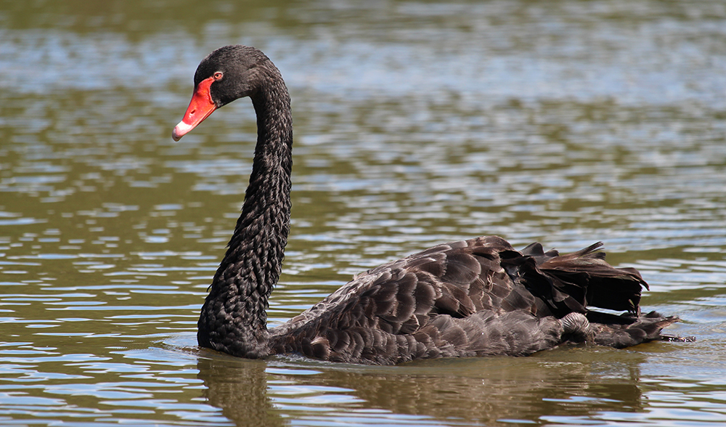
We need to be able to deal with these cases

Slide 28
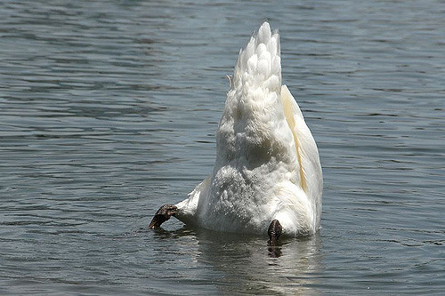
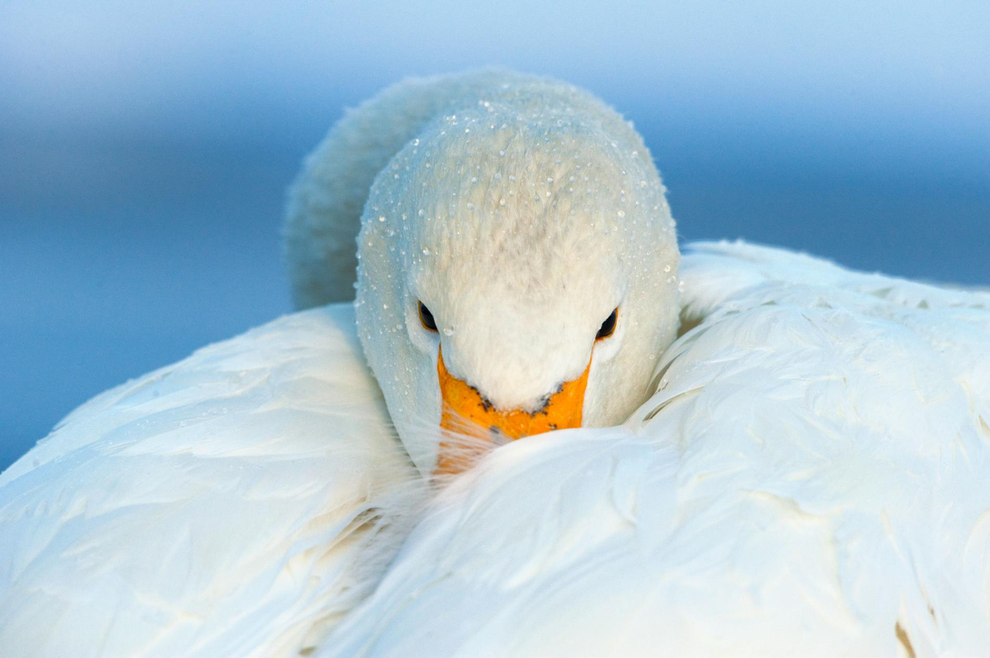


And these

Slide 29
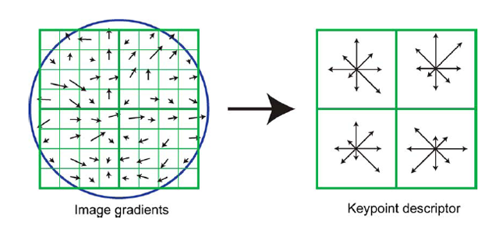
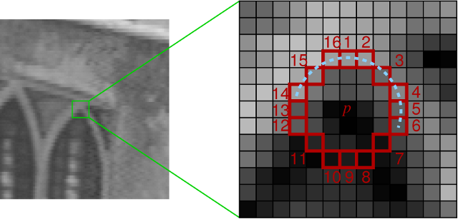
Image features
We’ve been basically talking about detecting features in images, in a very naïve way.
Researchers built multiple computer vision techniques to deal with these issues: SIFT, FAST, SURF, BRIEF, etc.
However, similar problems arose: the detectors where either too general or too over-engineered. Humans were designing these feature detectors, and that made them either too simple or hard to generalize.
SIFT feature descriptor
FAST corner detection algorithm

Slide 30
Image features (cont)
What if we learned the features to detect?
We need a system that can do Representation Learning (or Feature Learning).
Representation Learning: technique that allows a system to automatically find relevant features for a given task. Replaces manual feature engineering.
Multiple techniques for this:
Unsupervised (K-means, PCA, …).
Supervised (Sup. Dictionary learning, Neural Networks!)

Slide 31
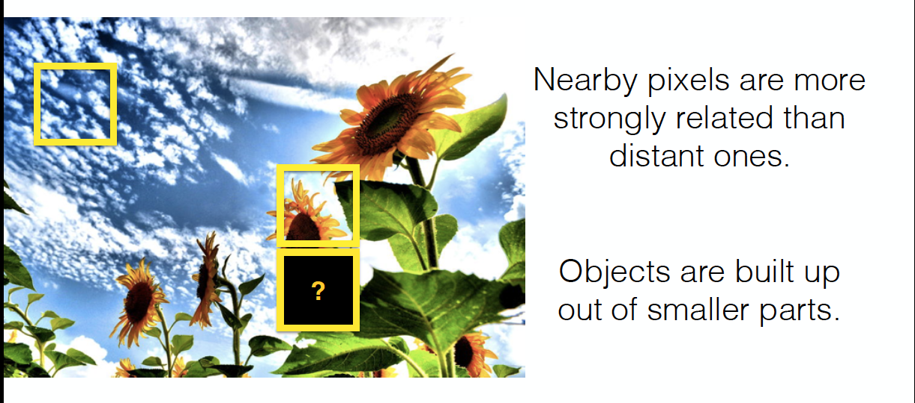
Images are Local and Hierarchical
Moreover

Slide 32
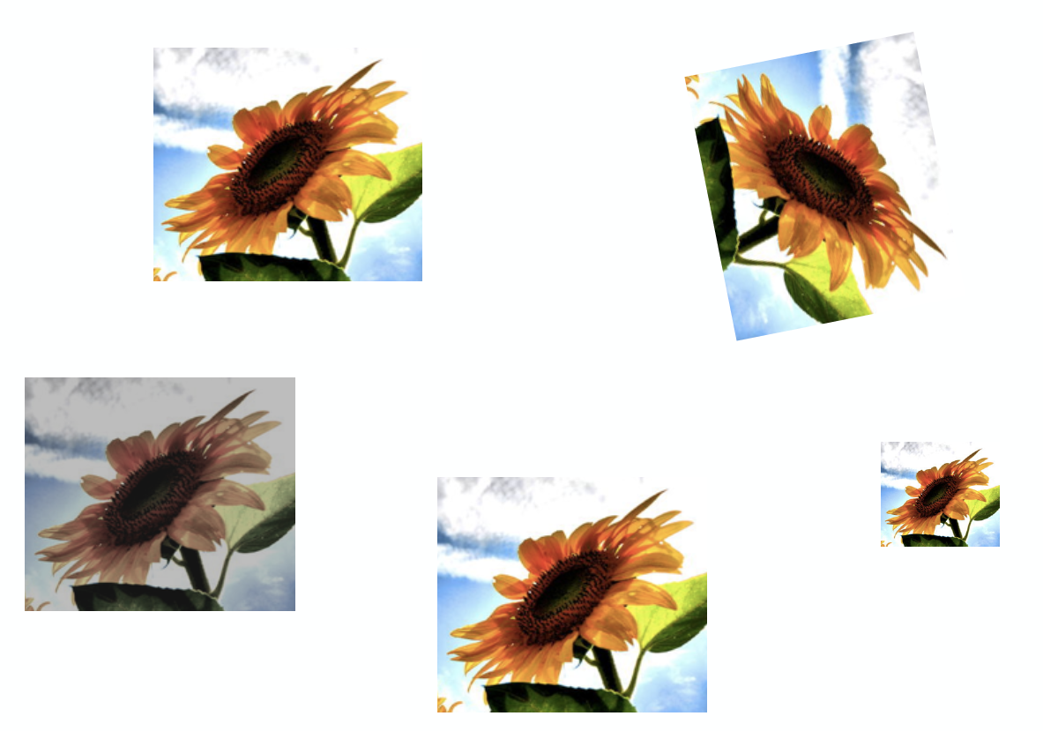
Images are Invariant

Slide 33
Outline
Motivation
CNN basic ideas
Building a CNN

Slide 34
Each neuron from first layer has one weight per pixel. Recall, the importance of the predictors (here pixels) is given by the value of the coefficient (here W).
X
In this case, the red weights will be modified to better recognize cat.
X
In this case, the blue weights will be modified.
We are learning redundant features. Approach is not robust, as cats could appear in yet another position.

Slide 35
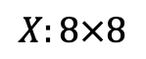
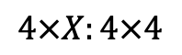
Solution: Cut the image to smaller pieces.
$$4×X:4×4$$
$$X:8×8$$

Slide 36
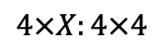
Do the same for all images
$$4×X:4×4$$

Slide 37
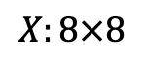
$$4×X:4×4$$
But what if cat is not the box?
$$X:8×8$$

Slide 38
$$4×X:4×4$$
But what if cat is not the box?
$$X:8×8$$

Slide 39
$$4×X:4×4$$
But what if cat is not the box?
$$X:8×8$$

Slide 40
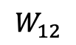
















Convolution
$$x_{11}$$
$$h_{1}=f(W_{11}x_{11}+W_{12}x_{12}+…+W_{44}x_{44})$$
$$x_{12}$$
$$⋮$$
$$⋮$$
$$x_{44}$$
Input
Hidden Layer
$$W_{11}$$
$$W_{12}$$
$$W_{13}$$
$$W_{14}$$
$$x_{11}$$
$$x_{12}$$
$$x_{13}$$
$$x_{14}$$
$$×$$
$$W_{44}$$
$$x_{44}$$

Slide 41

“Convolution” Operation

Slide 42


Convolutions – step by step

Slide 43

Convolutions – another example

Slide 44

Convolution and cross-correlation
A convolution of f and g $(f∗g)$ is defined as the integral of the product, having one of the functions inverted and shifted:
$$\left(f∗g\right)\left(t\right)=\int_{a}{f\left(a\right)g\left(t−a\right)da}$$
Discrete convolution:
$$\left(f∗g\right)\left(t\right)=\sum_{a=−∞}^{∞}{f\left(a\right)g(t−a)}$$
Discrete cross-correlation:
$$\left(f⋆g\right)\left(t\right)=\sum_{a=−∞}^{∞}{f\left(a\right)g(t+a)}$$
Function is inverted and shifted left by t

Slide 45



“Convolution” Operation in action
Kernel
Edge detection
*
=
Sharpen
*
=
wikipedia.org

Slide 46
A Convolutional Network
+ ReLU
+ ReLU

Slide 47
Why more than one feature map?
Feature 1: Horizontal Lines
Feature 2: Vertical Lines
Feature 3: Orange bulb

Slide 48
Why more than one layer?
Layer 2, Feature 1: Combine horizontal and vertical lines from Layer 1 produce diagonal lines.
Layer 3, Feature 1: Combine diagonal to identify shapes

Slide 49
So far
We know that MLPs:
Do not scale well for images
Ignore the information brought by pixel position and correlation with neighbors
Cannot handle translations
The general idea of CNNs is to intelligently adapt to properties of images:
Pixel position and neighborhood have semantic meanings.
Elements of interest can appear anywhere in the image.

Slide 50

Basics of CNNs
MLP
CNN
CNNs are also composed of layers, but those layers are not fully connected: they have filters, sets of cube-shaped weights that are applied throughout the image. Each 2D slice of the filters are called kernels.
These filters introduce translation invariance and parameter sharing.
How are they applied? Convolutions!

Slide 51

Convolutions – what happens at the edges?
If we apply convolutions on a normal image, the result will be down-sampled by an amount depending on the size of the filter.
We can avoid this by padding the edges in different ways.

Slide 52


Padding
Full padding. Introduces zeros such that all pixels are visited the same amount of times by the filter. Increases size of output.
Same padding. Ensures that the output has the same size as the input.

Slide 53



Stride
Stride controls how the filter convolves around the input volume.
The formula for calculating the output size is:
$$O=\frac{W−K+2P}{S}+1$$
Where O is output dim, W is the input dim, K is the filter size, P is padding and S the stride
Stride = 1
Stride = 2

Slide 54


Convolutional layers
Convolutional layer with four 3x3 filters on an RGB image. As you can see, the filters are now cubes, and they are applied on the full depth of the image..
Convolutional layer with four 3x3 filters on a black and white image (just one channel)

Slide 55

Convolutional layers (cont)
To be clear: each filter is convolved with the entirety of the 3D input cube, but generates a 2D feature map.
Because we have multiple filters, we end up with a 3D output: one 2D feature map per filter.
The feature map dimension can change drastically from one conv layer to the next: we can enter a layer with a 32x32x16 input and exit with a 32x32x128 output if that layer has 128 filters.

Slide 56


Slide 57
Learning CNN
In a convolutional layer, we are basically applying multiple filters at over the image to extract different features.
But most importantly, we are learning those filters!
One thing we’re missing: non-linearity.

Slide 58

ReLU
The most successful non-linearity for CNNs is the Rectified Non-Linear unit (ReLU):
Combats the vanishing gradient problem occurring in sigmoids, is easier to compute, generates sparsity (not always beneficial)

Slide 59
Convolutional layers so far
A convolutional layer convolves each of its filters with the input.
Input: a 3D tensor, where the dimensions are Width, Height and Channels (or Feature Maps)
Output: a 3D tensor, with dimensions Width, Height and Feature Maps (one for each filter)
Applies non-linear activation function (usually ReLU) over each value of the output.
Multiple parameters to define: number of filters, size of filters, stride, padding, activation function to use, regularization.

Slide 60
A Convolutional Network
+ ReLU
+ ReLU

Slide 61
Pooling
Invariant to small, “local transitions”
Face detection: enough to check the presence of eyes, not their precise location
Reduces input size to final fully connected layers
No learnable parameters
1 | 1 | 2 | 5
5 | 7 | 7 | 8
3 | 1 | 1 | 0
1 | 2 | 3 | 4
7
7
8
max pool with 2x2 window
and stride 1

Slide 62
Pooling (cont)
1 | 1 | 2 | 5
5 | 7 | 7 | 8
3 | 1 | 1 | 0
1 | 2 | 3 | 4
max pool with 2x2 window
and stride 2
7 | 8
3 | 4
1 | 1 | 2 | 5
5 | 7 | 7 | 8
3 | 1 | 1 | 0
1 | 2 | 3 | 4
mean pool with 2x2 window
and stride 2
7 | 11
3.5 | 4

Slide 63
A Convolutional Network
+ ReLU
+ ReLU

Slide 64
Building a CNN
A convolutional neural network is built by stacking layers, typically of 3 types:
Convolutional Layers
Pooling Layers
Fully connected Layers

Slide 65
Building a CNN
Convolutional Layers
A convolutional neural network is built by stacking layers, typically of 3 types:
Action
Apply filters to extract features
Filters are composed of small kernels, learned.
One bias per filter.
Apply activation function on every value of feature map
Parameters
Number of kernels
Size of kernels (W and H only, D is defined by input cube)
Activation function
Stride
Padding
Regularization type and value
I/O
Input: 3D cube, previous set of feature maps
Output: 3D cube, one 2D map per filter
Pooling Layers
Fully connected Layers

Slide 66
Building a CNN
A convolutional neural network is built by stacking layers, typically of 3 types:
Convolutional Layers
Pooling Layers
Fully connected Layers

Slide 67
Building a CNN
Pooling Layers
A convolutional neural network is built by stacking layers, typically of 3 types:
Action
Reduce dimensionality
Extract maximum of average of a region
Sliding window approach
Parameters
Stride
Size of window
I/O
Input: 3D cube, previous set of feature maps
Output: 3D cube, one 2D map per filte, reduced spatial dimensions
Convolutional Layers
Fully connected Layers

Slide 68
Building a CNN
A convolutional neural network is built by stacking layers, typically of 3 types:
Convolutional Layers
Pooling Layers
Fully connected Layers

Slide 69
Building a CNN
Fully connected Layers
A convolutional neural network is built by stacking layers, typically of 3 types:
Action
Aggregate information from final feature maps
Generate final classification
Parameters
Number of nodes
Activation function: usually changes depending on role of layer. If aggregating info, use ReLU. If producing final classification, use Softmax.
I/O
Input: FLATTENED 3D cube, previous set of feature maps
Output: 3D cube, one 2D map per filter
Convolutional Layers
Pooling Layers

Slide 70

Fully built CNN (VGG)

Slide 71
What do CNN layers learn?
Each CNN layer learns filters of increasing complexity.
The first layers learn basic feature detection filters: edges, corners, etc.
The middle layers learn filters that detect parts of objects. For faces, they might learn to respond to eyes, noses, etc.
The last layers have higher representations: they learn to recognize full objects, in different shapes and positions.

Slide 72


Slide 73
Examples
I have a convolutional layer with 12 4x4 filters that takes an RGB image as input.
What else can we define about this layer?
Activation function
Stride
Padding type
How many parameters does the layer have?
12 x 4 x 4 x 3 + 12 = 588
Number of filters
Size of Filters
Number of channels of prev layer
Biases (one per filter)

Slide 74
Examples
Let C be a CNN with the following disposition:
Input: 32x32x3 images
Conv1: 8 3x3 filters, stride 1, padding=same
Conv2: 16 5x5 filters, stride 2, padding=same
Flatten layer
Dense1: 512 nodes
Dense2: 4 nodes
How many parameters does this network have?
(8 x 3 x 3 x 3 + 8) + (16 x 5 x 5 x 8 + 16) + (16 x 16 x 16 x 512 + 512) + (512 x 4 + 4)
Conv1
Conv2
Dense1
Dense2

Slide 75
3D visualization of networks in action
http://scs.ryerson.ca/~aharley/vis/conv/
https://www.youtube.com/watch?v=3JQ3hYko51Y

